Slide 1
Reminder: elementary probability
Basic laws: 0 ≤ P(ω) ≤ 1 ∑_{ω ∈Ω} P(ω) = 1
Events: subsets of Ω: P(A) = ∑_{ω ∈ A} P(ω)
Random variable X(ω) has a value in each ω
Distribution P(X) gives probability for each possible value x
Joint distribution P(X,Y) gives total probability for each combination x,y
Summing out/marginalization: P(X=x) = ∑_{y} P(X=x,Y=y)
Conditional probability: P(X|Y) = P(X,Y)/P(Y)
Product rule: P(X|Y)P(Y) = P(X,Y) = P(Y|X)P(X)
Generalize to chain rule: P(X₁,..,X_{n}) = ∏_{i} P(X_{i} | X₁,..,X_{i-1})

Slide 2
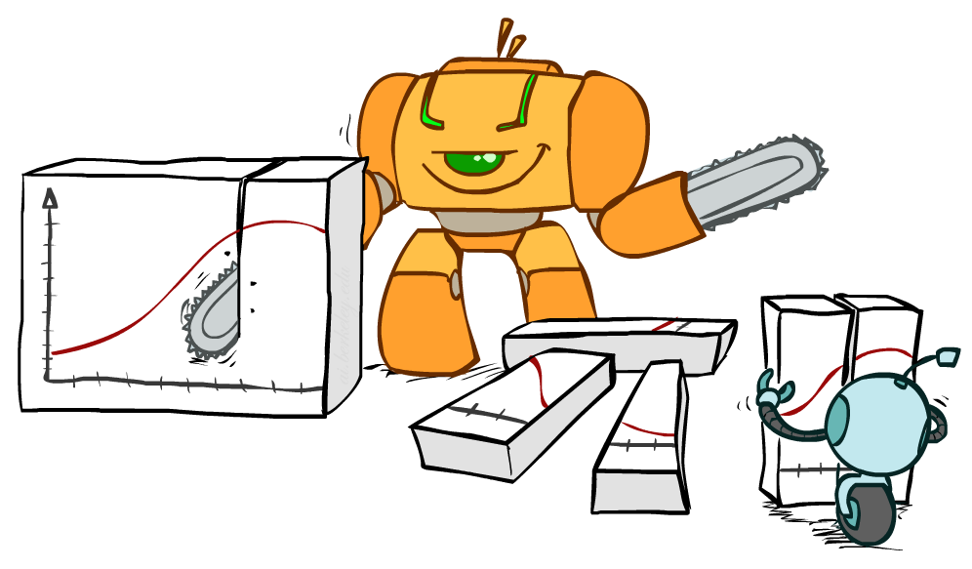
Bayes Rule

Slide 3
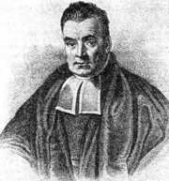
Bayes’ Rule
Write the product rule both ways:
P(a | b) P(b) = P(a, b) = P(b | a) P(a)
Dividing left and right expressions, we get:
Why is this at all helpful?
Lets us build one conditional from its reverse
Often one conditional is tricky but the other one is simple
Describes an “update” step from prior P(a) to posterior P(a | b)
Foundation of many systems we’ll see later (e.g. ASR, MT)
In the running for most important AI equation!
That’s my rule!
P(b | a) P(a)
P(b)
P(a | b) =

Slide 4
Inference with Bayes’ Rule
Example: Diagnostic probability from causal probability:
Example:
M: meningitis, S: stiff neck
Note: posterior probability of meningitis still very small: 0.008 (80x bigger – why?)
Note: you should still get stiff necks checked out! Why?
P(effect | cause) P(cause)
P(effect)
P(cause | effect) =
P(s | m) = 0.8
P(m) = 0.0001
P(s) = 0.01
Example
givens
P(s | m) P(m)
P(s)
0.8 x 0.0001 .
0.01
P(m | s) =
=

Slide 5

Probabilistic Inference
Probabilistic inference: compute a desired probability from a probability model
Typically for a query variable given evidence
E.g., P(airport on time | no accidents) = 0.90
These represent the agent’s beliefs given the evidence
Probabilities change with new evidence:
P(airport on time | no accidents, 5 a.m.) = 0.95
P(airport on time | no accidents, 5 a.m., raining) = 0.80
Observing new evidence causes beliefs to be updated

Slide 6
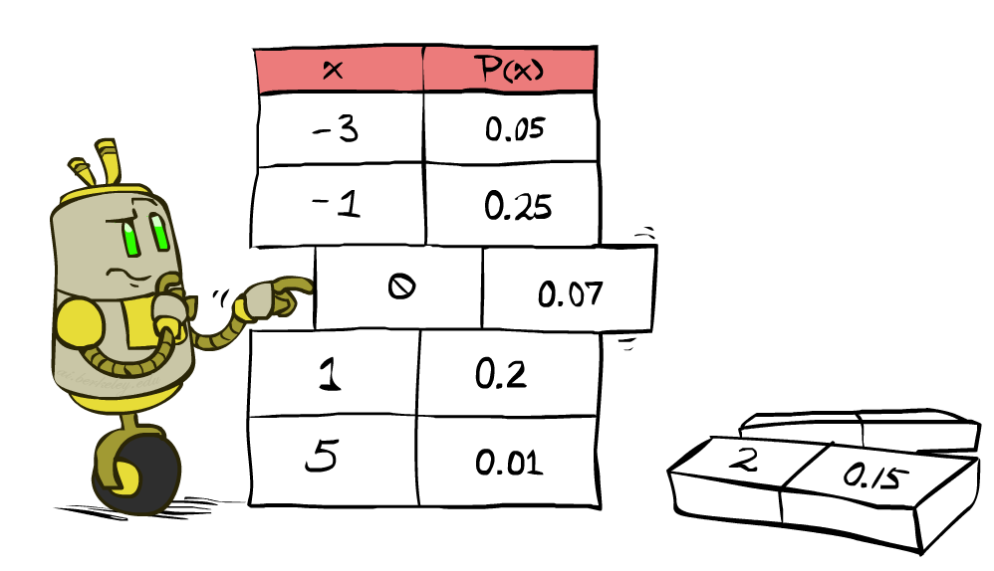
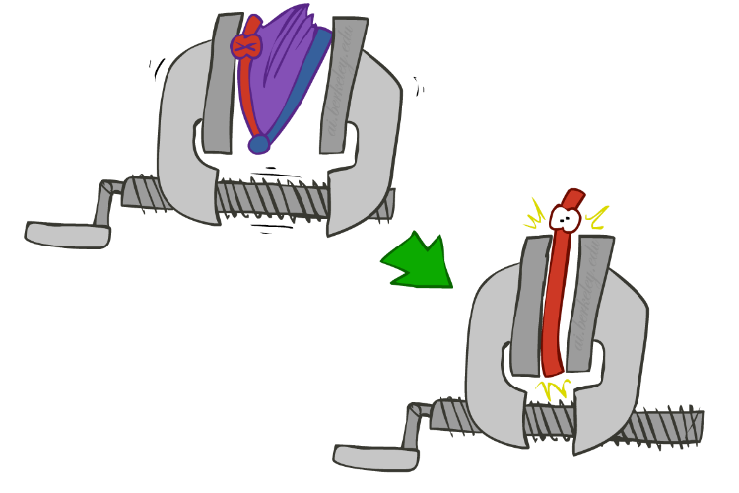
Inference by Enumeration
We want:
P(Q | e)
Probability model P(X₁, …, X_{n}) is given
Partition the variables X₁, …, X_{n} into sets as follows:
Evidence variables: E = e
Query variables: Q
Hidden variables: H
Step 1: Select the entries consistent with the evidence
Step 2: Sum out H from model to get joint of query and evidence
Step 3: Normalize
P(Q ,e) =
∑_{h} P(Q , h, e)
P(Q | e) = α P(Q ,e)
X₁, …, X_{n}

Slide 7
Inference by Enumeration
Season | Temp | Weather | P
summer | hot | sun | 0.35
summer | hot | rain | 0.01
summer | hot | fog | 0.01
summer | hot | meteor | 0.00
summer | cold | sun | 0.10
summer | cold | rain | 0.05
summer | cold | fog | 0.09
summer | cold | meteor | 0.00
winter | hot | sun | 0.10
winter | hot | rain | 0.01
winter | hot | fog | 0.02
winter | hot | meteor | 0.00
winter | cold | sun | 0.15
winter | cold | rain | 0.20
winter | cold | fog | 0.18
winter | cold | meteor | 0.00
P(W | winter)?

Slide 8
Inference by Enumeration
Obvious problems:
Worst-case time complexity O(d^{n})
Space complexity O(d^{n}) to store the joint distribution
O(d^{n}) data points to estimate the entries in the joint distribution

Slide 9

Independence
Two variables X and Y are (absolutely) independent if
∀x,y P(x, y) = P(x) P(y)
I.e., the joint distribution factors into a product of two simpler distributions
Equivalently, via the product rule P(x,y) = P(x|y)P(y),
P(x | y) = P(x) or P(y | x) = P(y)
Example: two dice rolls Roll₁ and Roll₂
P(Roll₁=5, Roll₂=3) = P(Roll₁=5) P(Roll₂=3) = 1/6 x 1/6 = 1/36
P(Roll₂=3 | Roll₁=5) = P(Roll₂=3)

Slide 10


Example: Independence
n fair, independent coin flips:
P(X₁)
P(X₂)
P(X_{n})
H | 0.5
T | 0.5
H | 0.5
T | 0.5
H | 0.5
T | 0.5
P(X₁,X₂,...,X_{n})
2^{n}

Slide 11
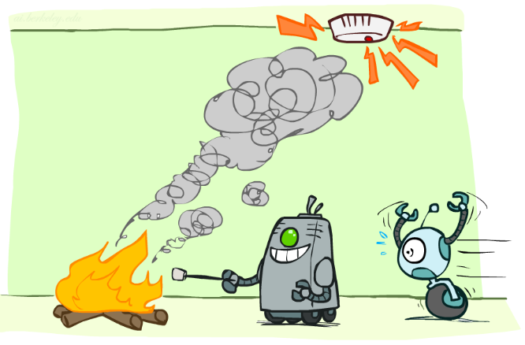
Conditional Independence

Slide 12
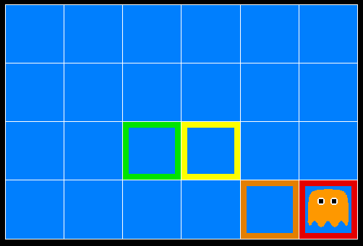
Ghostbusters
A ghost is in the grid somewhere
Sensor readings tell how close a square is to the ghost
On the ghost: usually red
1 or 2 away: mostly orange
3 or 4 away: typically yellow
5+ away: often green
Click on squares until confident of location, then “bust”

Slide 13

Video of Demo Ghostbusters with Probability

Slide 14
Ghostbusters model
0.11
0.11
0.11
Variables and ranges:
G (ghost location) in {(1,1),…,(3,3)}
C_{x,y} (color measured at square x,y) in {red,orange,yellow,green}
Ghostbuster physics:
Uniform prior distribution over ghost location: P(G)
Sensor model: P(C_{x,y} | G) (depends only on distance to G)
E.g. P(C_{1,1} = yellow | G = (1,1) ) = 0.1
0.11
0.11
0.11
0.11
0.11
0.11

Slide 15

Ghostbusters model, contd.
0.11
0.11
0.11
P(G, C_{1,1} , … C_{3,3}) has 9 x 4⁹ = 2,359,296 entries!!!
Ghostbuster independence:
Are C_{1,1} and C_{1,2} independent?
E.g., does P(C_{1,1} = yellow) = P(C_{1,1} = yellow | C_{1,2} = orange) ?
Ghostbuster physics again:
P(C_{x,y} | G) depends only on distance to G
So P(C_{1,1} = yellow | G = (2,3) ) = P(C_{1,1} = yellow | G = (2,3), C_{1,2} = orange)
I.e., C_{1,1} is conditionally independent of C_{1,2} given G
0.11
0.11
0.11
0.11
0.11
0.11

Slide 16
Ghostbusters model, contd.
Apply the chain rule to decompose the joint probability model:
P(G, C_{1,1} , … C_{3,3}) = P(G) P(C_{1,1} | G) P(C_{1,2} | G, C_{1,1}) P(C_{1,3} | G, C_{1,1}, C_{1,2}) … P(C_{3,3} | G, C_{1,1}, …, C_{3,2})
Now simplify using conditional independence:
P(G, C_{1,1} , … C_{3,3}) = P(G) P(C_{1,1} | G) P(C_{1,2} | G) P(C_{1,3} | G) … P(C_{3,3} | G)
I.e., conditional independence properties of ghostbuster physics simplify the probability model from exponential to quadratic in the number of squares
This is called a Naïve Bayes model:
One discrete query variable (often called the class or category variable)
All other variables are (potentially) evidence variables
Evidence variables are all conditionally independent given the query variable

Slide 17
Conditional Independence
Conditional independence is our most basic and robust form of knowledge about uncertain environments.
X is conditionally independent of Y given Z if and only if:
∀x,y,z P(x | y, z) = P(x | z)
or, equivalently, if and only if
∀x,y,z P(x, y | z) = P(x | z) P(y | z)

Slide 18
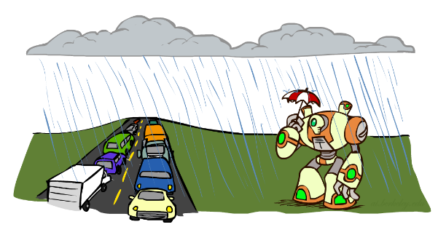
Conditional Independence
What about this domain:
Traffic
Umbrella
Raining

Slide 19

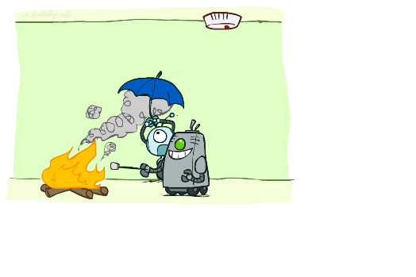
Conditional Independence
What about this domain:
Fire
Smoke
Alarm

Slide 20
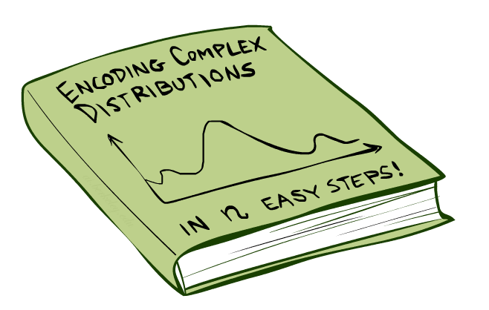
Bayes Nets: Big Picture

Slide 21
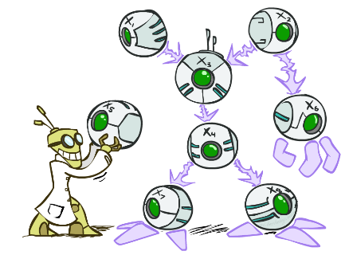
Bayes Nets: Big Picture
Bayes nets: a technique for describing complex joint distributions (models) using simple, conditional distributions
A subset of the general class of graphical models
Use local causality/conditional independence:
the world is composed of many variables,
each interacting locally with a few others

Slide 22
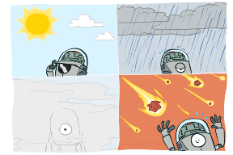
Graphical Model Notation
Nodes: variables (with domains)
Can be assigned (observed) or unassigned (unobserved)
Arcs: interactions
Indicate “direct influence” between variables
Formally: encode conditional independence (more later)
Weather
G
0.11
0.11
0.11
C_{1,1}
C_{1,2}
C_{3,3}
0.11
0.11
0.11
0.11
0.11
0.11

Slide 23

Example: Coin Flips
N independent coin flips
No interactions between variables: absolute independence
X₁
X₂
X_{n}

Slide 24
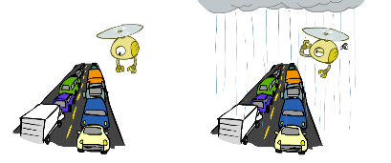
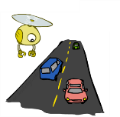
Example: Traffic
Variables:
T: There is traffic
U: I’m holding my umbrella
R: It rains
R
T
U

Slide 25
Example: Smoke alarm
Variables:
F: There is fire
S: There is smoke
A: Alarm sounds
F
S
A

Slide 26
Example Bayes’ Net: Car Insurance

Slide 27
Example Bayes’ Net: Car Won’t Start

Slide 28
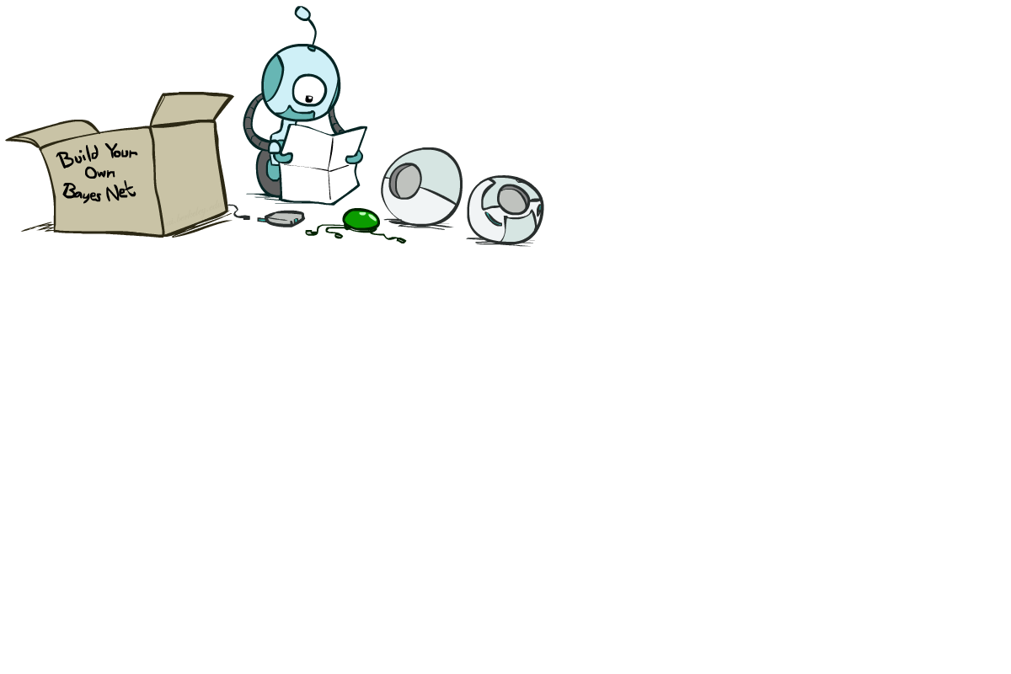
Bayes Net Syntax and Semantics

Slide 29
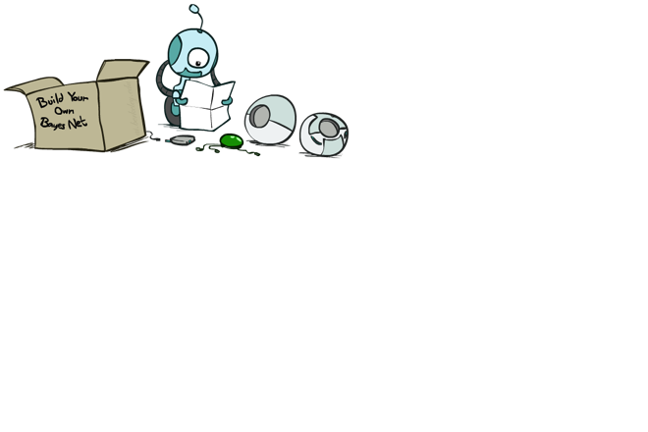
Bayes Net Syntax
A set of nodes, one per variable X_{i}
A directed, acyclic graph
A conditional distribution for each node given its parent variables in the graph
CPT (conditional probability table); each row is a distribution for child given values of its parents
P(G)
(1,1) | (1,2) | (1,3) | …
0.11 | 0.11 | 0.11 | …
G
C_{1,1}
C_{1,2}
C_{3,3}
G | P(C_{1,1} | G)
 | g | y | o | r
(1,1) | 0.01 | 0.1 | 0.3 | 0.59
(1,2) | 0.1 | 0.3 | 0.5 | 0.1
(1,3) | 0.3 | 0.5 | 0.19 | 0.01
…
Bayes net = Topology (graph) + Local Conditional Probabilities

Slide 30
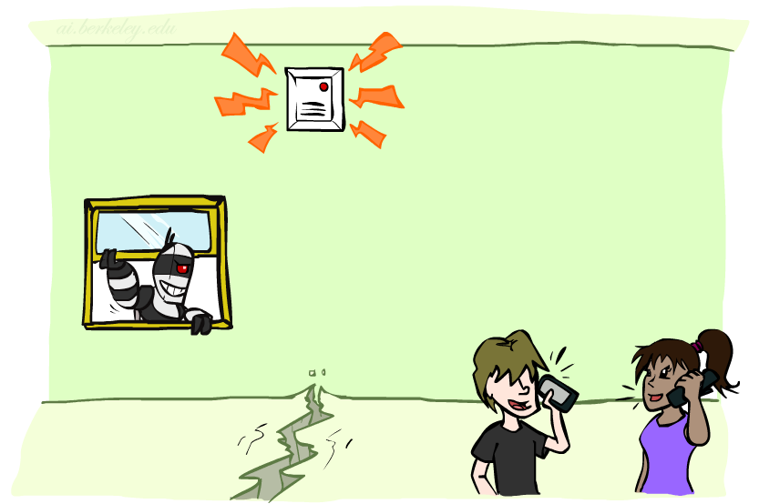
Example: Alarm Network
1
1
P(E)
true | false
0.002 | 0.998
P(B)
true | false
0.001 | 0.999
Burglary
Earthquake
B | E | P(A|B,E)
 |  | true | false
true | true | 0.95 | 0.05
true | false | 0.94 | 0.06
false | true | 0.29 | 0.71
false | false | 0.001 | 0.999
Alarm
4
Number of free parameters in each CPT:
Parent range sizes d₁,…,d_{k}
Child range size d
Each table row must sum to 1
(d-1) Π_{i} d_{i}
John calls
Mary calls
A | P(J|A)
 | true | false
true | 0.9 | 0.1
false | 0.05 | 0.95
A | P(M|A)
 | true | false
true | 0.7 | 0.3
false | 0.01 | 0.99
2
2
Notes:
demo

Slide 31
General formula for sparse BNs
Suppose
n variables
Maximum range size is d
Maximum number of parents is k
Full joint distribution has size O(d^{n})
Bayes net has size O(n .d^{k})
Linear scaling with n as long as causal structure is local

Slide 32
Bayes net global semantics
Bayes nets encode joint distributions as product of conditional distributions on each variable:
P(X₁,..,X_{n}) = ∏_{i} P(X_{i} | Parents(X_{i}))

Slide 33
Example
P(E)
true | false
0.002 | 0.998
P(b,¬e, a, ¬j, ¬m) =
P(B)
true | false
0.001 | 0.999
Burglary
Earthquake
P(b)
P(¬e)
P(a|b,¬e)
P(¬j|a)
P(¬m|a)
=.001x.998x.94x.1x.3=.000028
B | E | P(A|B,E)
 |  | true | false
true | true | 0.95 | 0.05
true | false | 0.94 | 0.06
false | true | 0.29 | 0.71
false | false | 0.001 | 0.999
Alarm
John calls
Mary calls
A | P(J|A)
 | true | false
true | 0.9 | 0.1
false | 0.05 | 0.95
A | P(M|A)
 | true | false
true | 0.7 | 0.3
false | 0.01 | 0.99

Slide 34
Conditional independence in BNs
Compare the Bayes net global semantics
P(X₁,..,X_{n}) = ∏_{i} P(X_{i} | Parents(X_{i}))
with the chain rule identity
P(X₁,..,X_{n}) = ∏_{i} P(X_{i} | X₁,…,X_{i-1})
Assume (without loss of generality) that X₁,..,X_{n} sorted in topological order according to the graph (i.e., parents before children), so Parents(X_{i}) ⊆ X₁,…,X_{i-1}
So the Bayes net asserts conditional independences P(X_{i} | X₁,…,X_{i-1}) = P(X_{i} | Parents(X_{i}))
To ensure these are valid, choose parents for node X_{i} that “shield” it from other predecessors

Slide 35
Example: Burglary
P(B)
true | false
0.001 | 0.999
P(E)
true | false
0.002 | 0.998
Burglary
Earthquake
Alarm
Burglary
?
Earthquake
?
?
Alarm
B | E | P(A|B,E)
 |  | true | false
true | true | 0.95 | 0.05
true | false | 0.94 | 0.06
false | true | 0.29 | 0.71
false | false | 0.001 | 0.999

Slide 36
Example: Burglary
P(A)
true | false
Alarm
Burglary
Earthquake
Alarm
?
?
A | B | P(E|A,B)
 |  | true | false
true | true
true | false
false | true
false | false
A | P(B|A)
 | true | false
true
false
Burglary
Earthquake
?
?
?

Slide 37
Conditional independence semantics
Every variable is conditionally independent of its non-descendants given its parents
Conditional independence semantics <=> global semantics

Slide 38
Markov blanket
A variable’s Markov blanket consists of parents, children, children’s other parents
Every variable is conditionally independent of all other variables given its Markov blanket

Slide 39

Summary
Independence and conditional independence are important forms of probabilistic knowledge
Bayes net encode joint distributions efficiently by taking advantage of conditional independence
Global joint probability = product of local conditionals
Next: how to answer queries, i.e., compute conditional probabilities of queries given evidence

